Slide 1
Public Health

Slide 2
The IOM Report in 1990 recommended ‘the development of integrated service systems that link community-based screening and brief intervention to assessment and referral activities’.
(Agerwala & McCance-Katz, 2012)
Notes:
The current model of SBIRT is based on the Institute of Medicine (IOM 1990) report, Broadening the Base of Treatment for Alcohol Problems. In this model, primary care and other community-based settings can be seen as hubs that serve to screen and identify patients with alcohol and other problems that can then be referred out
Institute of Medicine Division of Mental Health and Behavioral Medicine. (1990).
Broadening the base of treatment for alcohol problems. Washington, DC: National
Academy Press.

Slide 3
Substance use is a public health problem
like other public health problems, early disease detection is important
Notes:
“In SBIRT we believe that substance use is a public health problem and we arrive at solutions using a public health approach. Like other forms of screening, SBIRT seeks to identify potential problems before they are acute or chronic (and become more difficult and more expensive to treat). This allows us to intervene earlier. Examples from health care include getting your blood pressure checked (screening for hypertension), getting a Mammogram (screening for breast cancer), getting your blood drawn (screening for vitamin deficiencies, etc.) Note that these screenings do not provide a diagnosis (if a problem is suspected based on the screening results more tests may be necessary, i.e., referral to a specialist to assess and diagnose). Since we understand substance use as public health problem it follows that we would model what the health care system does. We want to provide universal screening to identify potential substance use problems, intervene prior to the onset of anything acute, and as a result delay or preclude a chronic problem.”
WHITBY, L.G. Screening for disease: Definitions and criteria. Lancet 2:819–822, 1974.
WILSON, J.M.G., AND JUNGNER, G. Principles and Practice of Screening for Disease. WHO Public Paper 34. Geneva: World Health Bibliography Organization, 1968.
Russell, M. (2004/2005). Screening in general health care. Alcohol Research and Health . Vol. 28 17-22.

Slide 4
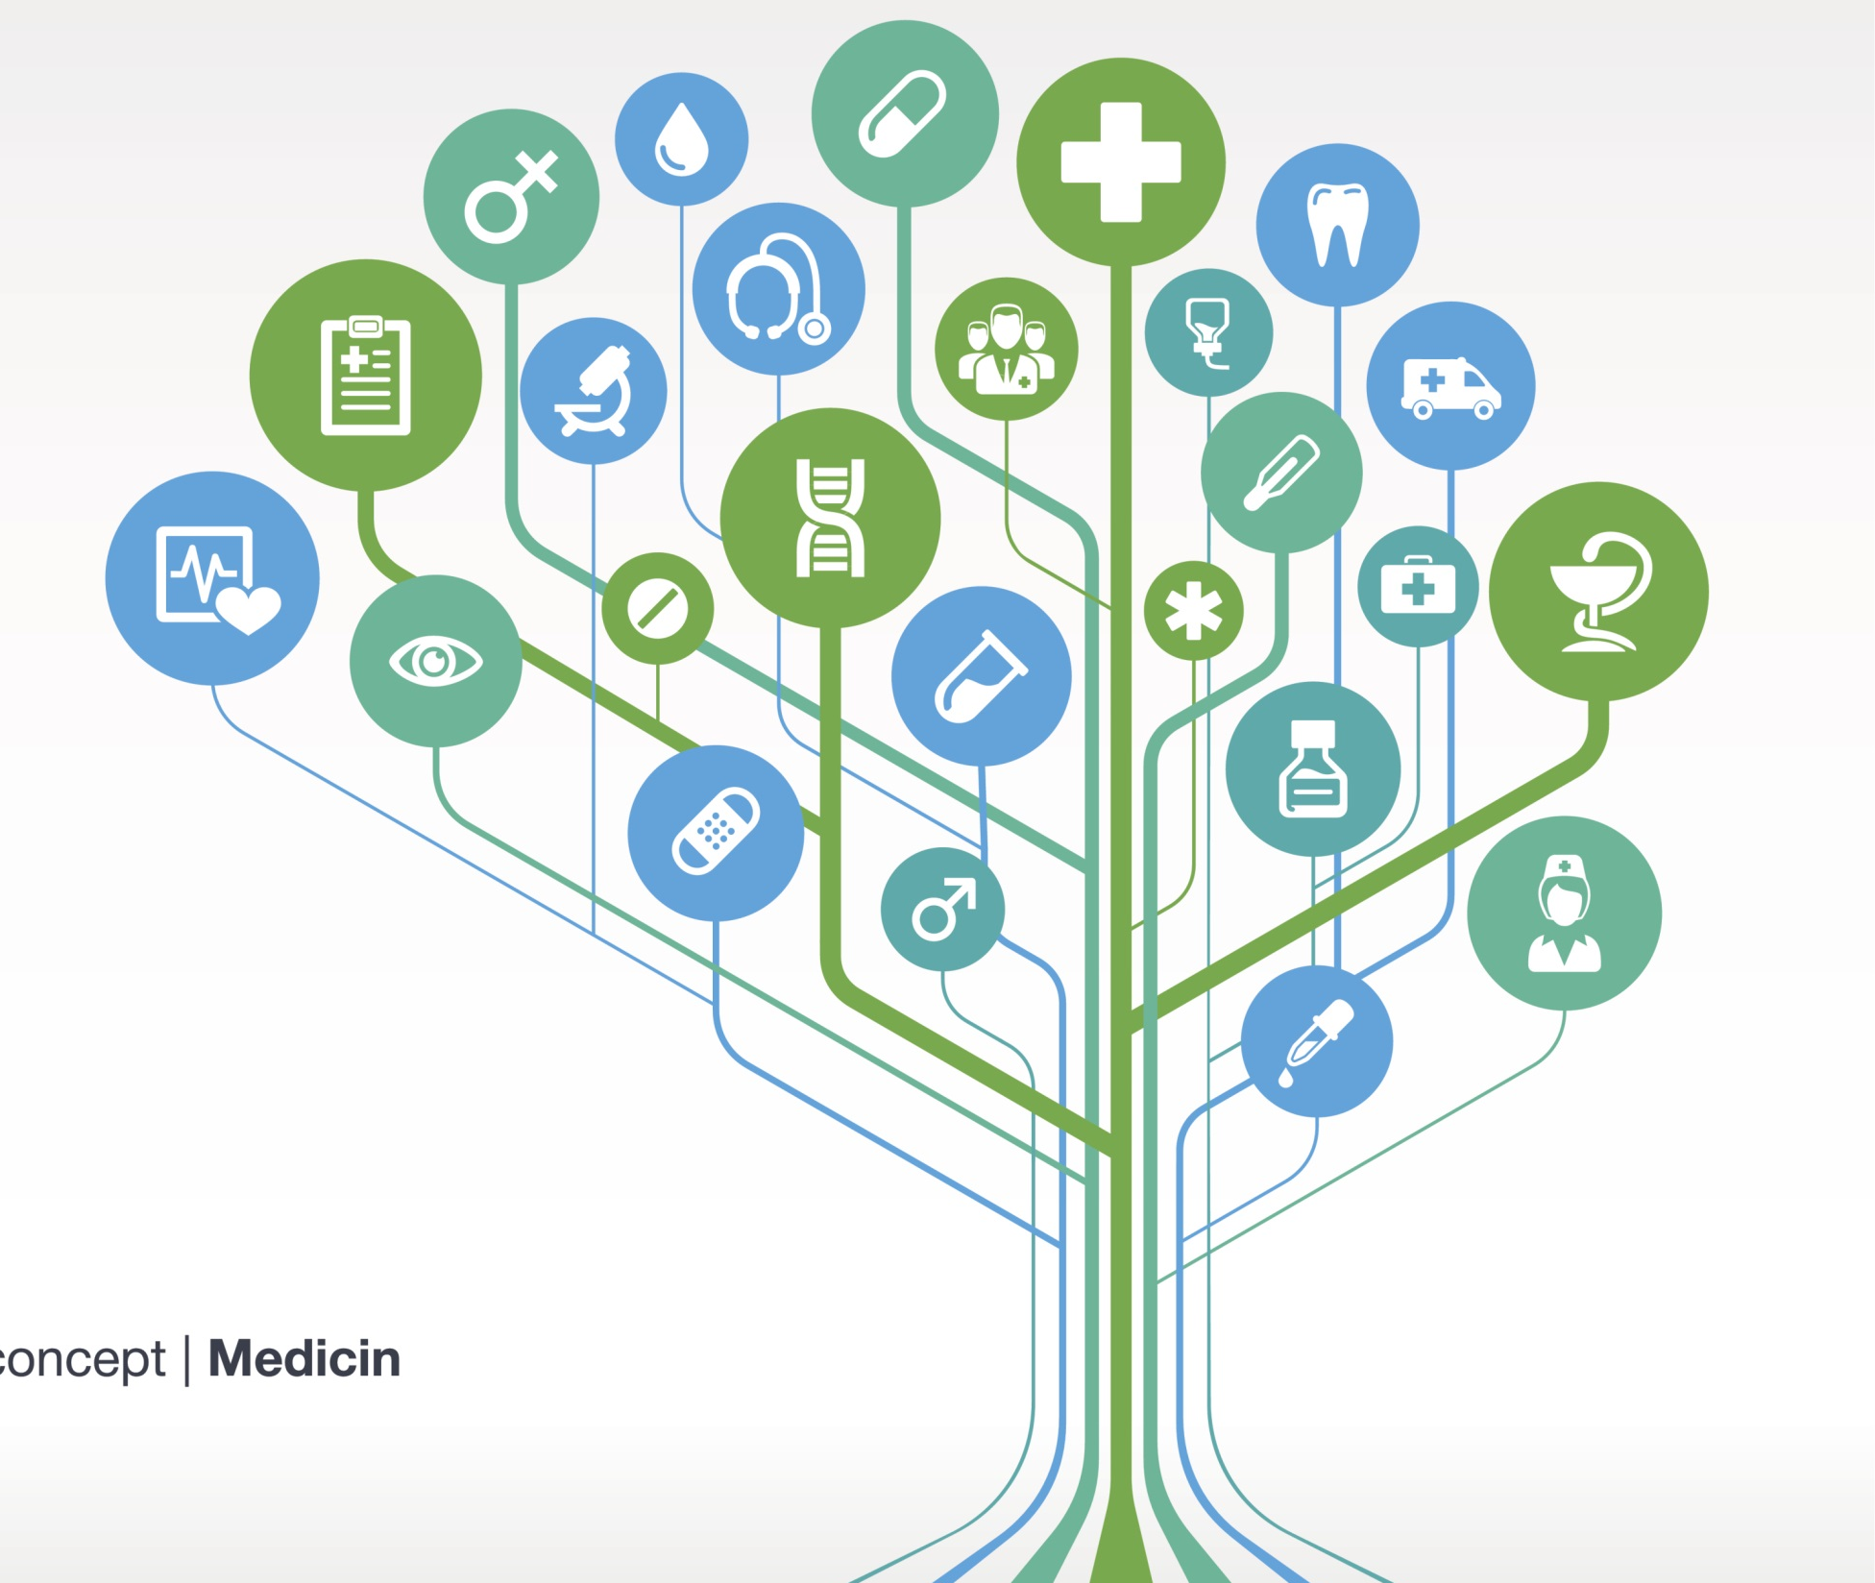
fits within a larger medical tradition
SBIRT
Notes:
“Thinking about SBIRT from a public health perspective helps to situate it within a large medical tradition of screening for early disease detection.”

Slide 5
Screening
a cornerstone of primary health care delivery
relatively recent medical practice
grew out of public health advances in the 1930s & 1940s
screening tests & primary preventive advice increased in the 1950s & 1960s
Primary Health Care Delivery
Screening
(Berg & Allan, 2001; Russell, 2004)
Notes:
“Screening is a cornerstone of primary health care delivery. As our knowledge of the natural history of disease has increased, so to has this public health approach to prevention and early identification.”
ASK “What other types of screening tests are you familiar with in primary care or other medical services?”
BERG, A.O., AND ALLAN, J.D. Introducing the third U.S. Preventive Services Task Force. American Journal of Preventive Medicine 20:3–4, 2001.

Slide 6
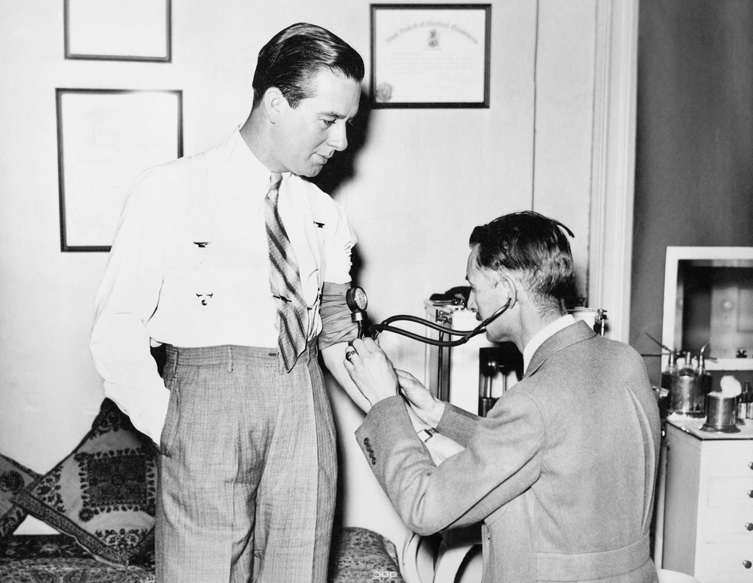
What is a blood pressure test?
Notes:
ASK “What is a blood pressure test?”
Elicit responses. (Responses will vary).
ANSWER: “A blood pressure test is a universal screen for hypertension. It does not diagnose heart disease. It gives the physician an indication
of a potential problem. If the patient’s blood pressure is high the physician can intervene at that point to identify what may be causing the problem (stress? smoking? diet?), assist the patient in lowering their blood pressure (exercise, smoking cessation, medication, etc.), or refer for additional tests and treatment if necessary.
ASK: “What parallels does a blood pressure test have to SBIRT?”
ASK: “Why do you think adoption of blood pressure screening is so high and SBIRT is lower?”

Slide 7
Principles of Early Disease Detection
Notes:
“From this public health perspective, we are encouraged to think about alcohol use in a way that will allow us to identify disease early.”

Slide 8
2 Levels of Screening
Universal
Provided to all adult patients
Serves to rule-out patients at low or no-risk
Can (should) be done at intake or triage
Positive universal screen proceed to full screen
Targeted
Provided to
specific patients (alcohol on breath; positive BAL; suspected alcohol/drug-related health problems)
patients who score positive on the universal screen
Notes:
“When trying to identify disease early, there are two types of screening options available: universal and targeted. While universal screening is recommended for risky alcohol use, most providers use targeted screening if they screen at all. Because we know that approximately 75% of the adult population will “rule out” it is advantageous to provide a simple universal screen. Once those individuals are ruled out the focus can shift to the remaining 25% who are likely at risk for a psycho-social or health care problem related to their current substance use choices.”

Slide 9
Conditions for Universal Screening
The condition should be a significant health problem.
The natural history of the condition should be understood.
There should be a recognizable latent or early symptomatic stage.
There should be a screening test/exam that can detect latent or early symptomatic stages of the disease & is acceptable to the population.
There should be an acceptable treatment for people who have the disease.
Treatment in the latent or early symptomatic stages of the disease should favorably influence its course & prognosis.
Facilities to diagnose & treat patients should be available.
There should be an agreed policy on whom to treat as patients.
Case-finding should be a continuing process, not a “one-shot” project.
The cost of diagnosis & treatment should be reasonable in relation to medical care costs as a whole.
(Wilson & Jungner, 1968; Whitby, 1974)
Notes:
“From a public health perspective, there are several criteria that should be met in order to merit universal screening. First, the condition should present a significant health problem. This is definitely the case with alcohol misuse, which is the 3rd leading actual cause of death in the United States. Secondly, the natural history of substance use disorders is well understood. The development of a substance use disorder is almost always preceded by a period of risky use. We are able to reliably detect risky substance use with array of screening instruments. There are efficacious treatment options available for those with risky use (brief intervention) and use disorders (specialty treatment, medication management). There are many opportunistic settings available in which to screen, diagnose, and conduct brief intervention. The US Preventive Services Task Force recommends annual screening in outpatient primary care settings, and the cost-effectiveness of SBIRT has been well established.”

Slide 10
Universal Screening
Drinking and drug use are common.
Drinking and drug use can increase the risk for health problems, safety risks, and a host of other issues.
Drinking and drug use often go undetected.
People are more open to change than you might expect

Slide 11
Universal Screening
Detecting alcohol and substance use patterns can help prevent future injury or illness
Like other conditions, prevention and early detection is essential

Slide 12
Rationale for Universal Screening
Alcohol and drug use are common
Male
Female | Substance | Male
24.4% | Tobacco | 37.6%
63.4% | Alcohol (current drinkers) | 69.4%
13.2% | Illicit drugs | 18.6%
5.6% | Prescription drug misuse | 6.1%
(SAMHSA, National Survey on Drug Use and Health, 2013, Ages 12+ in the US, past year use)

Slide 13
This type of intervention fills the gap between primary prevention and more intensive treatment for those with SUDs

