Slide 1
Rationale: Cost

Slide 2
Costs
How do you think risky drinking impacts our society financially?
Notes:
Ask: “How do you think risky drinking impacts our society financially? What sorts of costs might be a product of risky drinking?”

Slide 3
Excessive Drinking Cost the US $249 billion in 2010
(Sacks, Gonzales, Bouchery, Tomedi, and Brewer, 2015)
Notes:
“This is the latest estimate regarding the costs associated with excessive drinking. These costs have risen approximately 26 billion dollars since 2006 when costs for excessive drinking totaled $223.5 billion dollars. In 2010, binge drinking accounted for $191.1
billion (76.7%) of costs; underage drinking $24.3 billion (9.7%) of costs; and drinking while pregnant $5.5 billion (2.2%) of costs. The median cost per state was $3.5 billion.”
Sacks, J.J, Gonzales, K.R., Bouchery, EE, Tomedi, L.E., & Brewer, R.D. (2015). 2010 National and state costs of excessive alcohol consumption. American Journal of Preventive Medicine. 49, e73-79.

Slide 4
Costs include …
Motor vehicle crashes
Specialty Care for Abuse/Dependence
Criminal Justice corrections
Alcohol-related crimes
Hospitalizations
Lost Productivity
Mortality
FASD
Notes:
“Costs associated with excessive drinking can be broken down into different domains. The list here highlights some of the top costs of excessive drinking.”

Slide 5
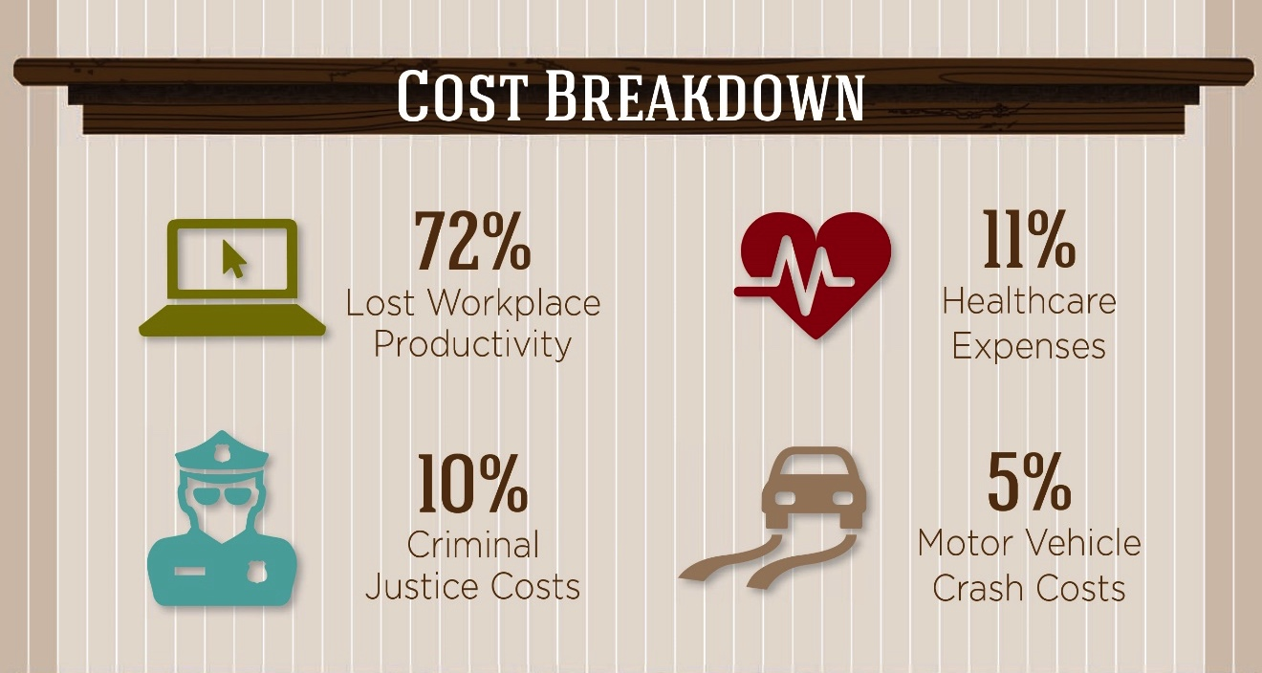
Cost Breakdown
Notes:
“There are lots of ways in which risky drinking affects society financially. These include lost workplace productivity, healthcare expenses for acute and chronic effects, criminal justice costs, and costs associated with motor vehicle crashes.”

Slide 6
Excessive drinking accounts for 1 in 10 deaths among working age adults
Total deaths in Nevada that were alcohol attributable were 11.6% of working age adults
Notes:
“In addition, risky drinking impacts us financially by depleting our workforce. More than 1 in 10 deaths among working age adults are caused by risky alcohol use.”

Slide 7
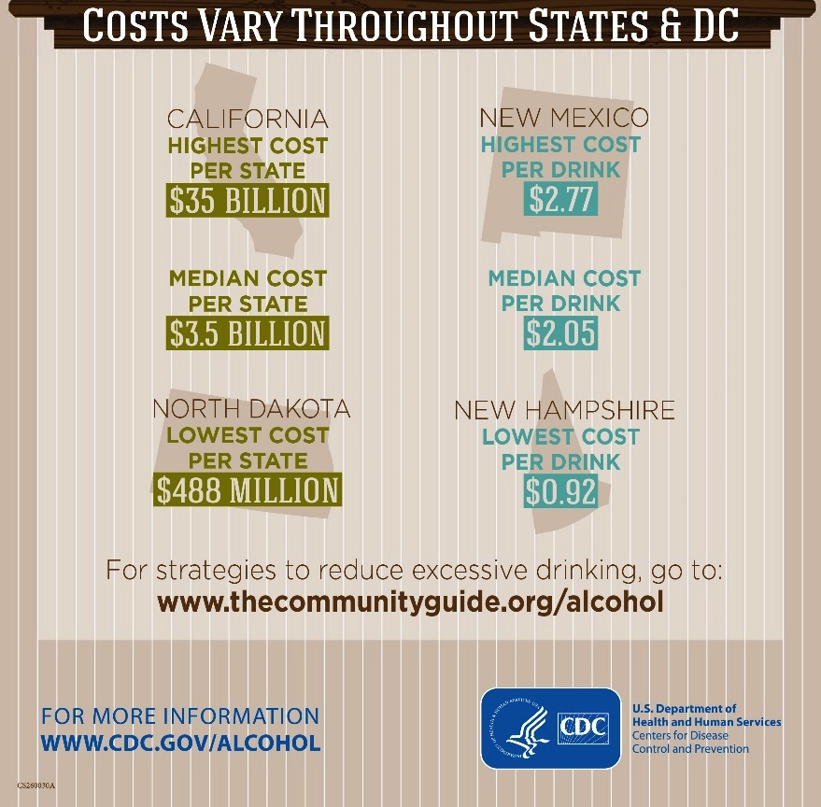
Costs vary throughout states & D.C.
Notes:
“Costs attributable to alcohol vary by state. As you can seen in the green, California has the highest cost per state and North Dakota has the smallest. Some of this can be explained by differences in population size. On the right, in blue, are the economic cost of alcohol per drink. Here, we an see that there is great variability which is likely based on differences across states in other social determinants of health.

Slide 8
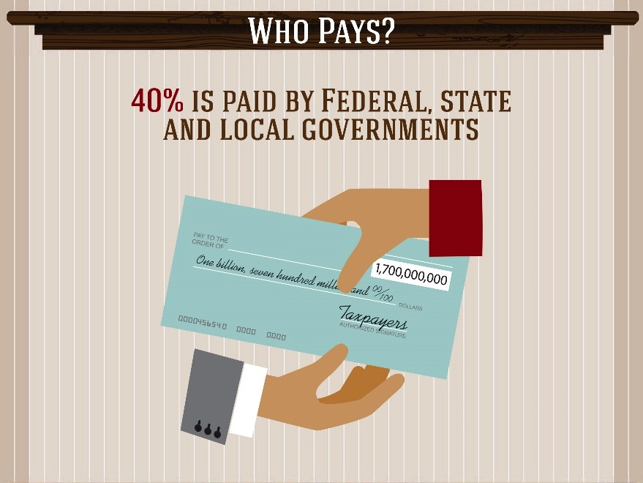
Who Pays?
Notes:
“A large portion of alcohol related costs are paid for by tax dollars collected through governmental agencies.”

Slide 9
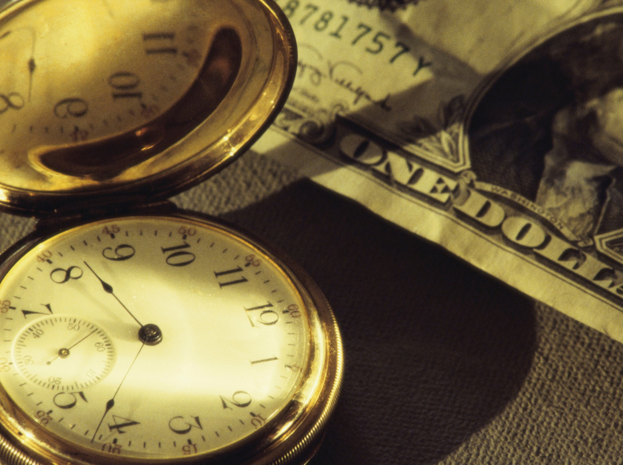
SBIRT
Late-stage intervention & substance abuse treatment is expensive, & the Client will often have developed comorbid health conditions.
reduces short- & long-term health care costs
saves lives & money by intervening early
is consistent with overall support for Client wellness

Slide 10
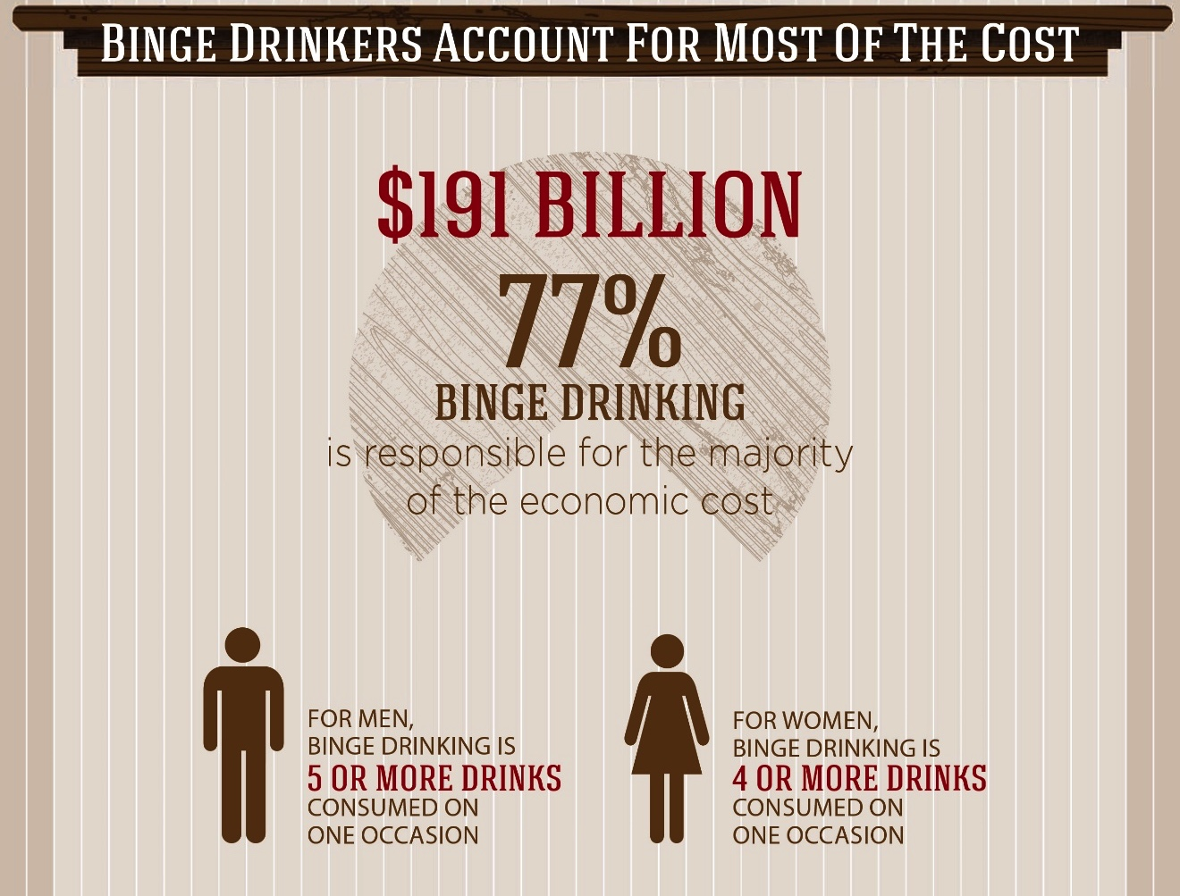
Binge drinkers account for most of the cost
Notes:
“When we look at the costs associated with alcohol, surprisingly to many, the costs are not primarily the byproduct of drinking by individuals with an alcohol use disorder, but, instead, from individuals who are drinking at risky levels.”

Slide 11
Economic costs of excessive drinking is likely to increase placing an ever greater burden on the excessive drinker, their family, society, and taxpayers
Excessive alcohol consumption is expensive
SBIRT is one of the evidence-based strategies to reduce costs
Notes:
“There are several evidence-based strategies that have demonstrated efficacy for decreasing excessive alcohol consumption. Those evidence-based strategies include: increasing alcohol excise taxes, limiting alcohol outlet density, and commercial host liability. In addition, SBIRT for adults is listed as one of the evidence-based practices.”

Slide 12
Cost-Effectiveness Study
SBRT is cost-effective – for every $1.00 spent on SBIRT services, $3.81 is saved
Notes:
“In a recent cost-effectiveness analysis, it was found that for every dollar spent on SBIRT services, nearly $4 were saved.”

Slide 13
The bulk of the societal, personal, and health care related costs are not a result of addiction but of excessive substance use.
Until such time as we acknowledge this fact, and address it appropriately, we are unlikely to make significant progress towards a solution.
Consider this…
Notes:
“Most of the costs associated with substance use problems are not a result of addiction but of excessive use. It is not the red light people who are driving the cost of substance use it is the yellow light people.”
This is an animated slide. After discussing click to start the animation sequence.

