Slide 1
What is Risky Use?

Slide 2
Thought exercise…
Think of a client you know for whom substance use has been a problem.
Notes:
“Understanding the rationale for SBIRT can sometimes be underscored through a little thought experience. Please take a moment and think of a client you know for whom alcohol or drug use has been a problem. If you haven’t had a lot of client contact, you can think of a friend or family member instead. Take a moment to really picture this person in your mind’s eye. What were they like. How did their alcohol or drug use affect them?”
PAUSE FOR ABOUT THIRTY SECONDS
“Now, I wonder whether I might be able to ask a few of you to share. Who would be willing to tell us about the person that came to mind for you?”
NOTE: Almost inevitably, participants will share stories of clients with severe substance use disorders. Reflect the main points of their examples.
“Thank you for sharing. As most of you have described the people that are most likely to come to mind when we think about clients for whom substance use has been a problem, often lie on the more severe end of the substance use spectrum.”

Slide 3
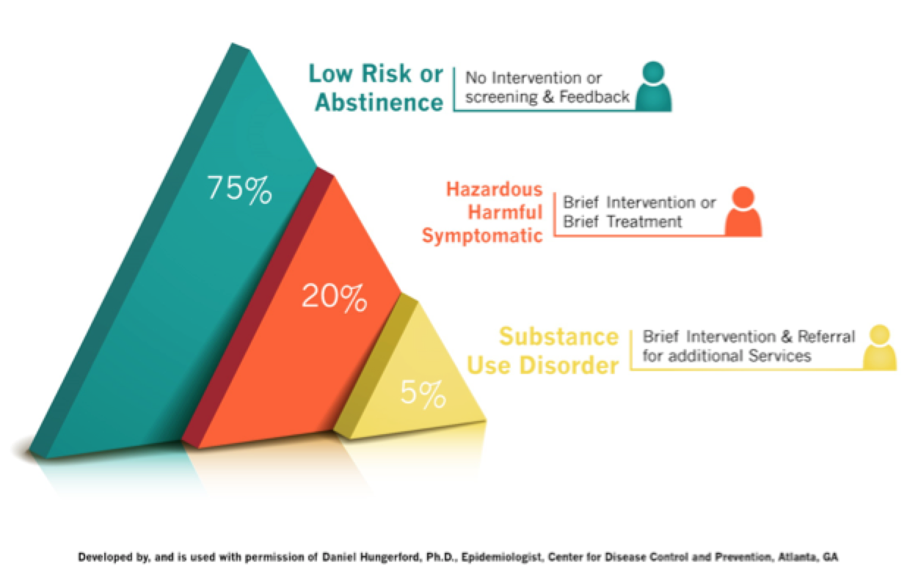
Thought exercise…
Think of a client you know for whom substance use has been a problem.
Notes:
“Substance use does lie on a continuum. Luckily, most client either do not use substances or, if they drink for example, do so in a safe manner. There is a pretty big population of clients however who use substances in a way that puts them at risk for medical or psychosocial consequences. This is actually about 1 in 5 clients. At the tip of the pyramid are clients who have a substance use disorder. These are clients who’s use has caused serious problems in their life. Even though these are minority of clients, as we saw with our thought example, these are the clients that are the first to come to mind. They stick out in our heads because they are the clients we are most concerned about and often most frustrated with. While this phenomenon is common, it creates a bit of a problem for SBIRT. When providers this of substance use only in terms of the most severe cases, it likely makes them less likely to intervene, because it can be challenging to see how a brief opportunistic intervention could have much of an impact. SBIRT encourages us to make deliberate efforts to think about the whole pyramid. Specifically, we are encouraged to think about the group of risky drinkers in the middle, who is often overlooked. These clients often fly below the radar of medical or other professionals because they are not yet experiencing serious consequences because of their drinking or drug use. However, it is this group of clients that create the most burden on our health and economic systems because of their use and it is this group that is most likely to be responsive to brief interventions that can be offered in opportunistic settings like medical offices.

Slide 4
Forget everything you know about:
Notes:
“When learning about SBIRT, you’ll be asked to forget a few things…”

Slide 5
• What constitutes a substance use problem • How substance use problems are identified • How to treat substance use problems
Notes:
“You’ll be asked to forget everything know about substance use problems, how they are identified, and how they are treated. For most learners, the concept of SBIRT is new and unique. Many of you will have biases or beliefs that SBIRT will challenge. It is important to be open to thinking and doing things differently.”

Slide 6
SBIRT may require a reframing of substance use
How do most people think about and understand substance use now?
Notes:
ASK: “What is the traditional way of viewing substance use disorders?”
-Ideal answers: binary, dichotomous, specialty treatment or no treatment, tertiary prevention

Slide 7
SBIRT may require a reframing of substance use
How is SBIRT different?
Notes:
“How is SBIRT different?”
Ideal answers: continuum of risk, early intervention, secondary prevention

Slide 8
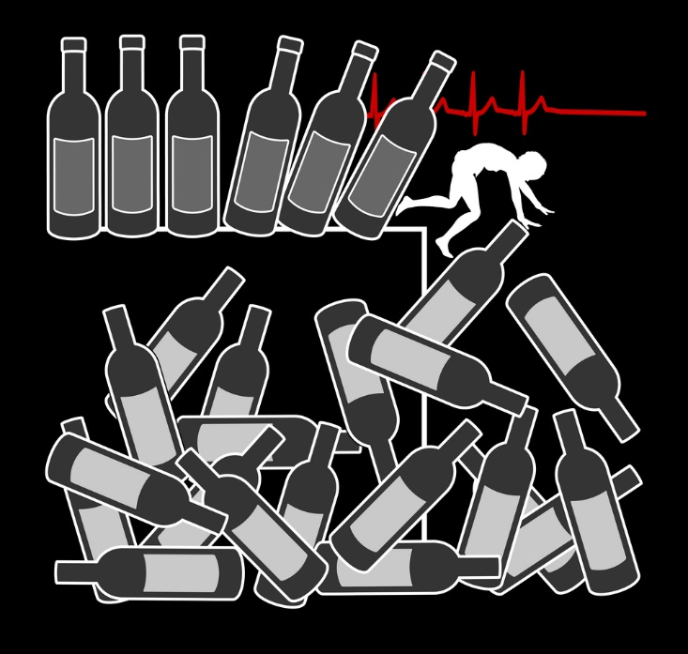
How would you define risky alcohol use?
Notes:
Ask “If you were asked to come up with a definition of risky alcohol use, what would it be?”

Slide 9
Low-risk drinking limits
Low-risk drinking limits | Men | Women
On any single DAY | No more than 4 drinks on any day | No more than 3 drinks on any day
 | -- AND -- | -- AND --
Per WEEK | No more than 14 drinks per week | No more than 7 drinks per week
To stay low risk, keep within BOTH the single-day AND weekly limits.
(National Institute of Alcohol Abuse and Alcoholism; www.NIAAA.nih.gov)
Notes:
“This is the way the National Institute of Alcohol Abuse and Alcoholism defines risk. For healthy men under 65, it is recommended that they drink no more than 4 drinks per day (acute measure) AND not more than 14 drinks per week (chronic measure). For healthy women and men over 65 the cutoff is less than or equal to 3 drinks per day AND not more than 7 drinks per week. Drinking over these amounts places the individual at risk for psycho-social or health care problem related to their alcohol use.”
ASK: “What do you make of these limits. Do they seem high? Low? Or about what you would expect?”
Be prepared for a variety of answers. Reflect learner perceptions and do not attempt to correct or persuade.”
ASK: “People obviously differ in their susceptibility to health and social consequences. For example, things like body weight, alcohol metabolism, and use of harm reduction strategies may affect the impact that alcohol has on a person. Why then, do you think we have developed guidelines that are more universal. What are some of the benefits and drawbacks of having one set of limits that apply to almost everyone?”
Reference: National Institute of Alcohol Abuse and Alcoholism; www.NIAAA.nih.gov.

Slide 10
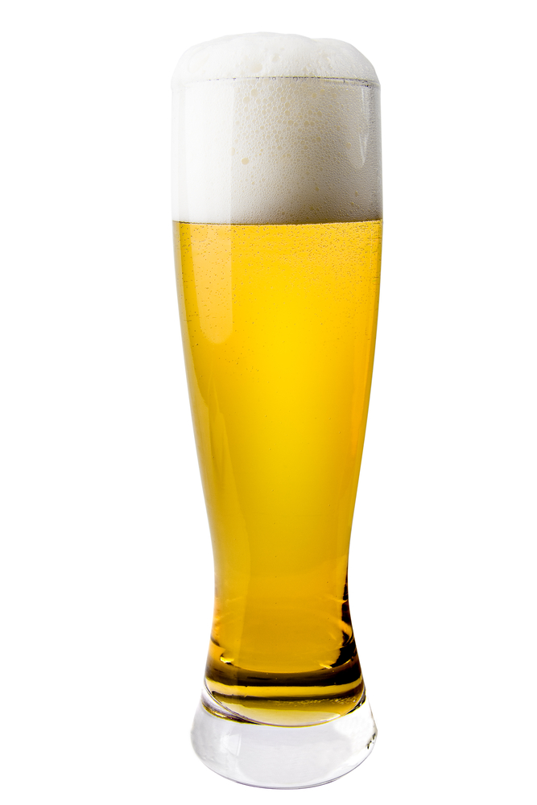
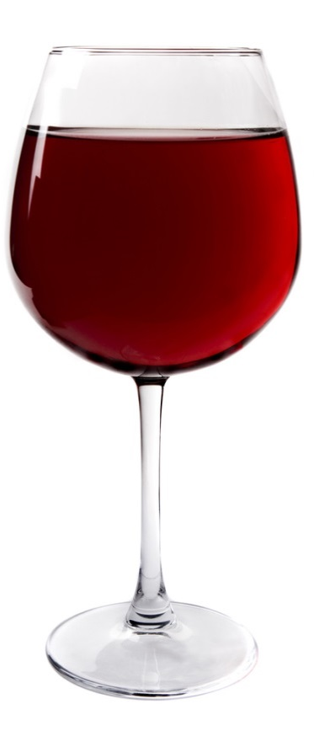
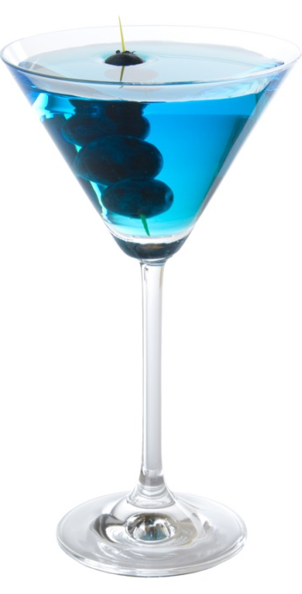
The Pour Game
12 ounces of beer
1.5 ounces of hard alcohol
5 ounces of wine
Notes:
“It’s important when talking about alcohol use here and with our clients to make sure that we are all on the same page about what constitutes a drink. A standard drink is 14 grams of alcohol which is equivalent to 5 ounces of wine, 12 ounces of beer, or a shot of hard alcohol.”
Activity: The Pour Game

Slide 11
Times when even 1 or 2 drinks can be TOO MUCH
younger than 21
driving or operating machinery
pregnant or breast-feeding
trying to conceive
taking certain medications that may interact with alcohol and cause harmful reactions
certain medical conditions that are worsened by alcohol (liver disease, hypertriglyceridemia, pancreatitis, hepatitis)
a history of a substance use disorder
Notes:
“There are times when the NIAAA drinking limits are not applicable.

Slide 12
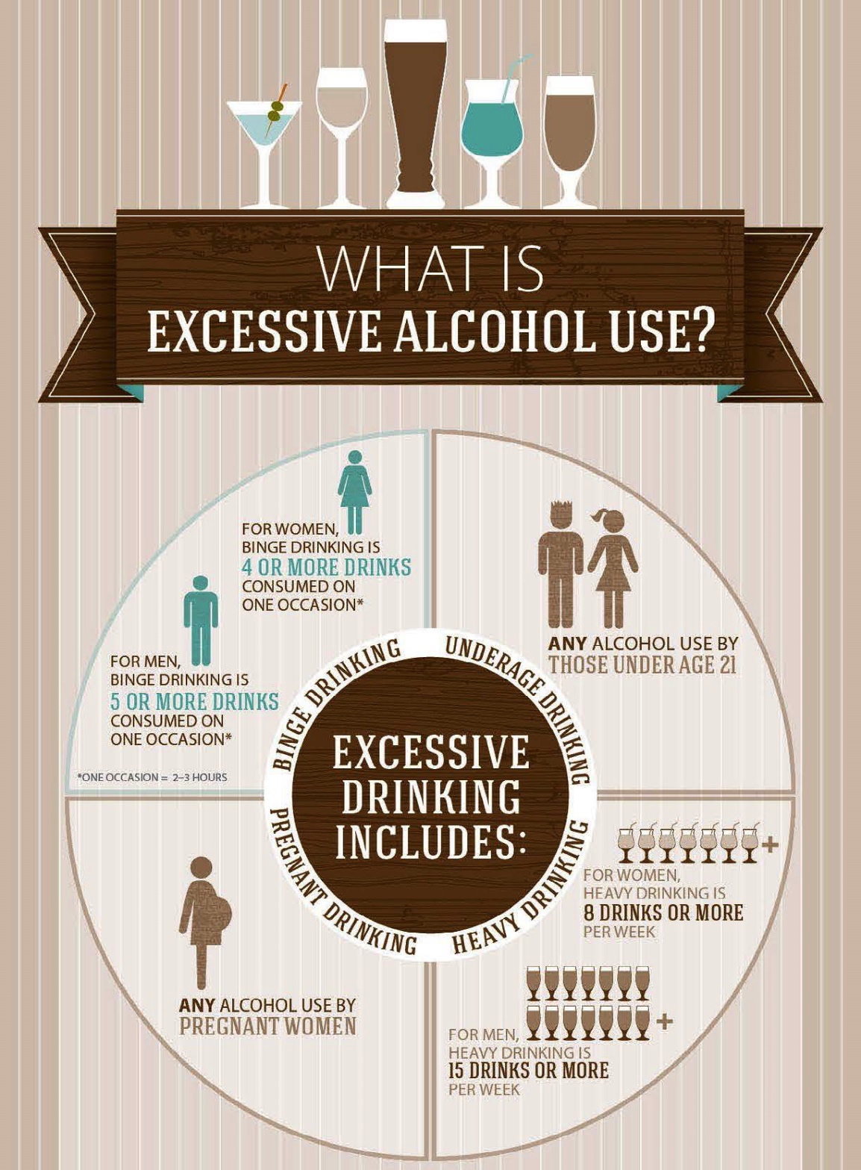
What is excessive alcohol use?

Slide 13
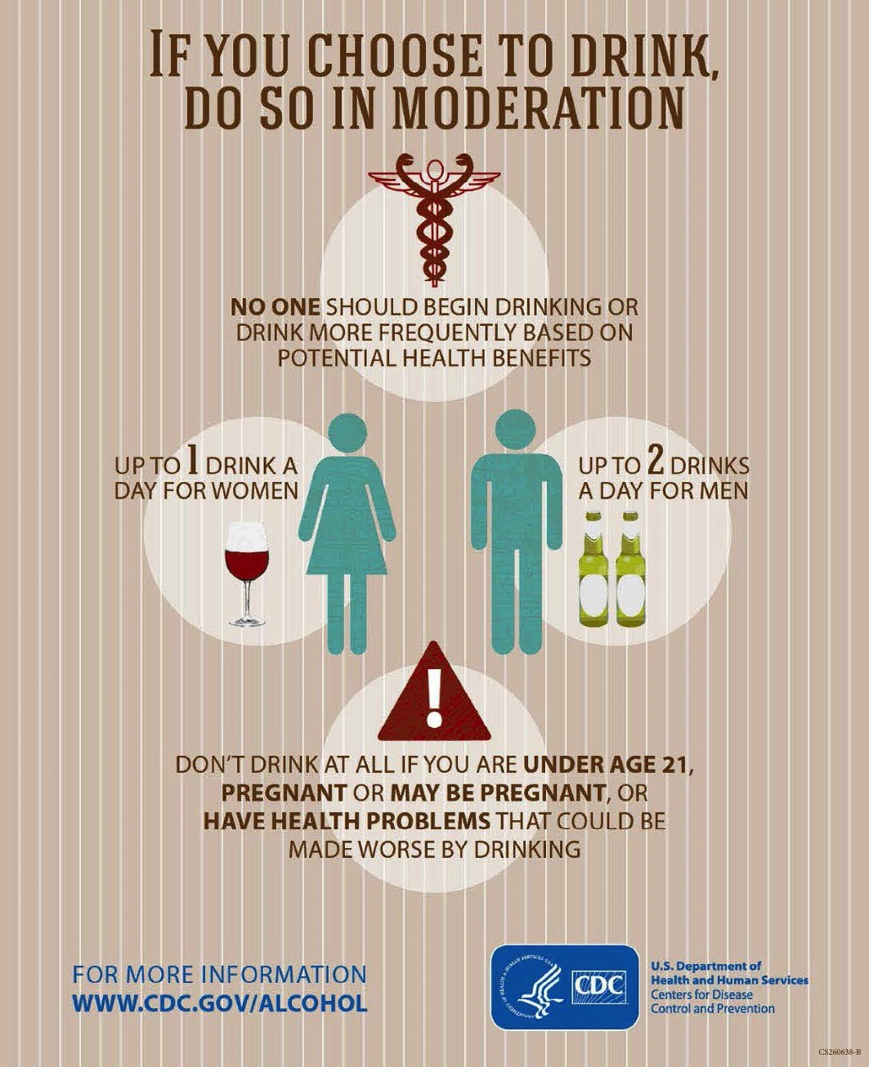
If you choose to drink, do so in moderation

Slide 14
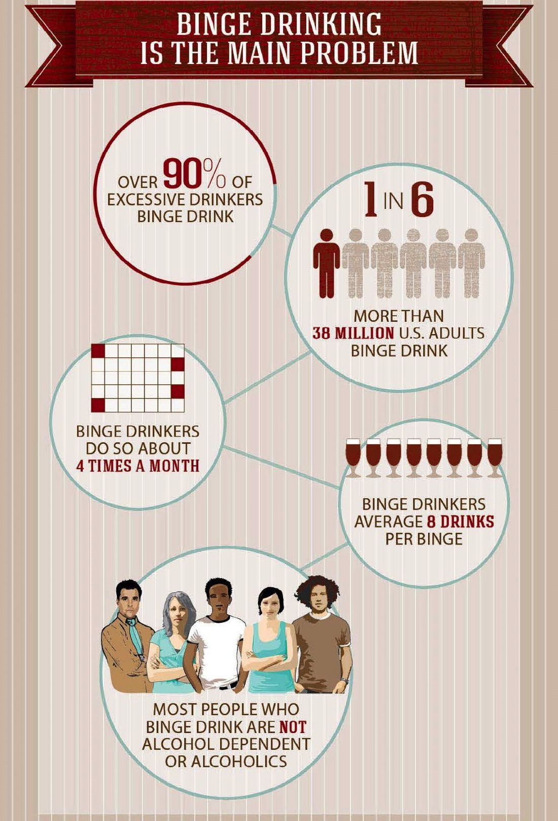
Binge drinking is the main problem

Slide 15
What do you think of these limits?
What do you think your students will think of these limits?

Slide 16
Where did the healthy drinking amounts come from?

Slide 17
Drinking too much
fires
falls
drowning
motor vehicle crashes
pedestrian injuries
alcohol poisoning
assaults
intimate partner violence
child abuse
property crimes
suicide
homicide
intoxication
too
fast
acute effects
drinking too much
cancer
liver cirrhosis
pancreatitis
gastroenteritis
addiction
hypertension
cardiovascular disease
fetal alcohol syndrome
neurologic damage
too
often
chronic effects
cell injury

Slide 18
Evidence behind the numbers…
Studies demonstrate that the 5+/4+ limits accurately reflect the amount of alcohol consumed at which psychomotor and cognitive impairment is notably increased in both men and women.

Slide 19
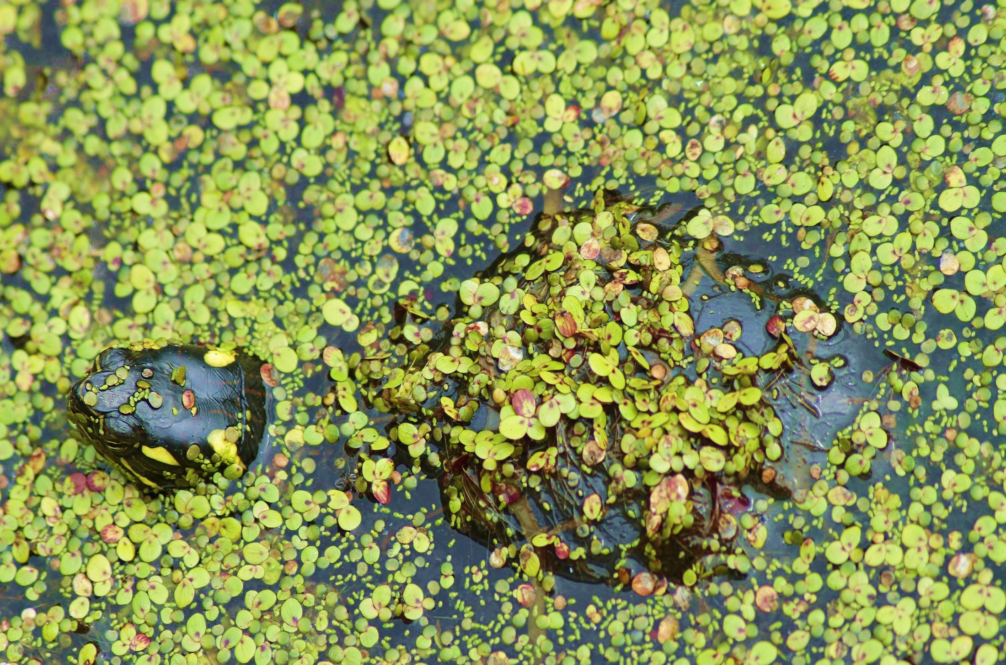
“Alcohol is a big preventable cancer risk factor that has been hiding in plain sight.”
(Naimi et al., 2013)

Slide 20
NIAAA Epidemiologic Studies
extensive, nationally representative, epidemiologic surveys including—
National Longitudinal Alcohol Epidemiologic Survey—NLAES (1992)
National Epidemiologic Survey on Alcohol and Related Conditions—NESARC (2001–2002)
NESARC 3-year follow-up (2004–2005)
included questions about the frequency with which people drank more than 5 drinks in a given day
findings indicated that exceeding these drinking limits can significantly increase alcohol-related health problems

Slide 21
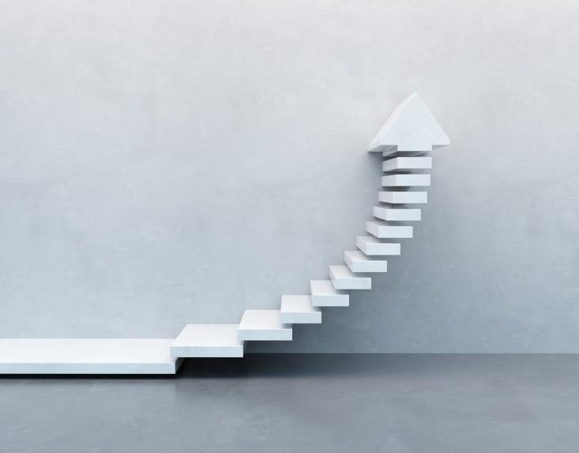
Epidemiologic risk curve analyses reveal significant and rapid increases in the risks of—
Unintentional injuries
Deaths resulting from external causes
Being a target of aggression or taking part in an aggression-related event
Alcohol use disorders
Unfavorable medical, work-related, legal, and social consequences related to drinking
As the frequency of exceeding NIAAA’S guidelines increases, the likelihood of developing these problems increases.

Slide 22
Risky Drug Use
How would you define risky drug use?
Notes:
Purpose: This also role models the ASK-TELL-ASK technique that participant’s will learn as part of brief intervention.

Slide 23
SBIRT also addresses risky drug use
“Risky" drug use includes any use of
a recreational* drugs and use of a prescription medication for
non-­ medical reasons.
* Recreational drugs include methamphetamines (speed; crystai); cannabis (marijuana; pot); inhalants (paint thinner; aerosol; glue); tranquilizers {diazepam); barbiturates; cocaine; ecstasy; hallucinogens (LSD & mushrooms); and narcotics (heroin).

